Slide 1

Introduction to Machine Learning Project
Masters of Science in Software Engineering
Bronwyn Trump
An end-to-end, leakage-safe, production-deployed malware detection system
Notes:
This project focuses on building an end-to-end machine learning system for malware detection. I’ll walk through the problem, the data, the modelling decisions, what went wrong, and how I fixed it.

Slide 2
Agenda
• Problem framing and dataset risks • Data integrity controls (stratification & locked hold-out) • EDA findings and feature behaviour • Leakage discovery and pipeline remediation • Model comparison and risk-driven selection • Final evaluation on unseen data • Production packaging, CI/CD, and deployment • Key engineering lessons learned
Notes:
The goal was not just to train a high-performing model, but to build something production-ready. That means correct evaluation, no data leakage, packaging, testing, CI/CD, and deployment.

Slide 3
Problem Context & Dataset
Binary malware classification using static executable features.
The dataset contains high-dimensional numeric attributes, missing values, and multiple identifier-style fields with no predictive value, requiring careful preprocessing.
A strict stratified 80/20 train–test split was created early, with the test set permanently locked to preserve evaluation integrity.
Malware detection is a high-risk classification problem where false negatives represent missed threats. As a result, generalization and evaluation integrity were prioritised over raw accuracy, directly shaping model selection and validation strategy.
Static executable features are especially prone to information leakage and spurious correlations. To avoid misleading performance estimates, disciplined evaluation and leakage control were treated as first-order design constraints.
The primary modelling objective was to maximise recall while maintaining low false-positive rates, prioritising security risk mitigation over headline accuracy.
Notes:
We worked with a labelled dataset of software binaries, classified as malware or benign. A key constraint was to lock away a hold-out test set early and never reuse it.

Slide 4
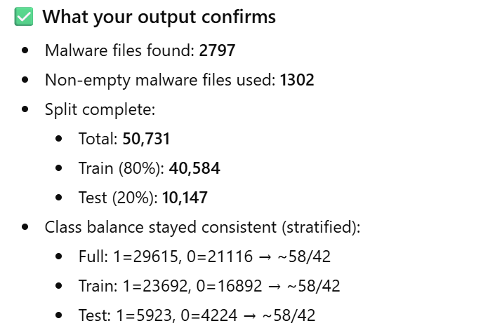
Stratified 80/20 train-test split Lock hold-out set
A stratified 80/20 train-test split was created once at project inception to preserve class proportions across all datasets.
The 20% hold-out test set was explicitly locked and excluded from feature engineering, cross-validation, and model selection to prevent indirect overfitting and optimistic bias.
This ensured that all reported final metrics reflect true out-of-sample generalisation rather than iterative tuning effects.
Appendix A for Program Execution
Notes:
After performing a stratified 80/20 split, the 20% test set was treated as a locked hold-out set.
All model training, preprocessing, and hyperparameter tuning were performed exclusively on the 80% training data using cross-validation.
The hold-out test set was not accessed during development and was used only once at the end to evaluate final model performance.
This approach ensures that the reported results reflect true generalisation rather than optimisation on the test data.
Intent: To obtain an unbiased estimate of real-world performance and avoid evaluation contamination. Decision: We created a stratified 80/20 split once and permanently locked the hold-out test set from all model selection and tuning. Outcome: Final performance metrics reflect true generalisation rather than optimistic results from repeated experimentation.

Slide 5
Exploratory Data Analysis (EDA)
EDA Outcomes and Design Impact
Exploratory analysis revealed that several identifier-style fields (e.g. hashes, timestamps, imported symbol lists) contained no predictive signal and were removed to prevent noise and leakage.
Feature distribution analysis showed heavy overlap between benign and malicious samples, indicating that no single feature was discriminative and motivating the use of ensemble models over linear or rule-based approaches.
Missing value analysis identified sparsely populated columns and systematic gaps, leading to median imputation within the modelling pipeline rather than ad-hoc preprocessing.
Class balance inspection confirmed moderate imbalance (~58/42), informing the use of stratified splitting to preserve representative class proportions across training and evaluation sets.
Overall, EDA highlighted a high-dimensional, noisy feature space, directly shaping preprocessing, model selection, and evaluation strategy.
Appendix B – supporting code images
Notes:
Intent: To understand data quality risks that could invalidate downstream modelling. Decision: We explicitly analysed missing values and feature distributions before any modelling, removing identifier-style features rather than imputing them. Outcome: This reduced noise, simplified preprocessing, and ensured the model learned behavioural patterns rather than dataset artefacts.

Slide 6
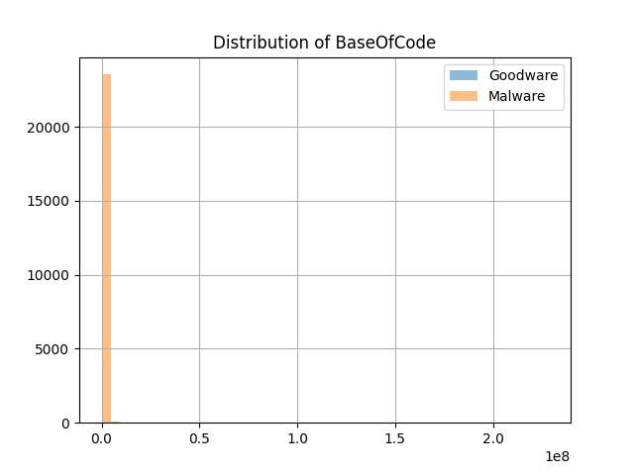
EDA: Feature Distributions
Both benign and malicious samples span the full range of BaseOfCode values, with substantial overlap between classes.
This overlap indicates that BaseOfCode provides limited standalone discriminative power and cannot reliably separate malware from benign executables in isolation.
As a result, feature-level analysis confirmed that classification must rely on joint patterns across multiple features, reinforcing the choice of ensemble and multivariate models rather than single-feature thresholds.
This finding also explains the strong dependence on feature interactions observed in later tree-based models.
Appendix C: Code Execution
Notes:
This slide shows example feature distribution plots from the exploratory data analysis.
A key observation here is that many numeric features exhibit strong right skew and long-tailed distributions rather than clean Gaussian shapes. This behaviour is typical of executable metadata, where certain properties are rare but extreme when present.
Because of this skewness, mean-based imputation would be highly sensitive to outliers and could distort the underlying signal. Instead, median imputation was selected as a more robust strategy.
Additionally, the wide range of feature scales motivated the use of feature scaling within the preprocessing pipeline. These decisions were driven directly by the empirical distribution patterns observed during EDA, rather than applied heuristically

Slide 7
EDA Findings and Engineering Impact
Exploratory analysis revealed multiple features with complete or near-complete missingness, along with identifier-style attributes (e.g. hashes, imported symbol metadata) that do not generalise across samples. These features were removed to reduce noise and prevent spurious correlations.
Feature distribution analysis showed substantial overlap between benign and malicious samples across individual attributes, confirming that no single feature provided sufficient discriminative power. This directly motivated the use of ensemble and tree-based models, which are capable of capturing complex, non-linear interactions across many weakly-informative features.

Slide 8
Pre-Processing – No Data Leakage Discovery
Early cross-validation results appeared unrealistically strong, triggering a structured audit of the training and evaluation pipeline.
The audit revealed that imputation and scaling were being applied outside cross-validation folds, allowing information from validation data to leak into training.
This issue was corrected by embedding all preprocessing steps inside a single scikit-learn Pipeline, ensuring transformations were fit only on training folds during cross-validation.
While headline performance decreased slightly, the resulting estimates were trustworthy, reproducible, and representative of true out-of-sample behaviour.
This correction converted the workflow from a high-risk experimental setup into a leakage-safe, production-aligned ML system, reinforcing that evaluation integrity must be engineered, not assumed.
Notes:
This was a critical turning point in the project. When initial results looked too good to be true, we audited the entire preprocessing workflow and discovered leakage caused by transformations being applied globally rather than within CV folds. Fixing this reduced apparent performance, but produced reliable estimates suitable for deployment. This reinforced that evaluation integrity is a system-level property, not something guaranteed by model choice alone.
Intent: To ensure cross-validation results reflected true model performance rather than leakage. Decision: After identifying leakage from preprocessing outside CV folds, we embedded imputation and scaling inside a Scikit-learn Pipeline. Outcome: Although metrics dropped slightly, performance became stable and reproducible, validating the integrity of the evaluation.

Slide 9
Feature Engineering Decisions
Feature engineering prioritised robustness and reproducibility over speculative performance gains.
EDA revealed that several identifier-style columns and non-numeric features carried no predictive signal and introduced inconsistency across modelling frameworks. These were removed to ensure stable behaviour across all model families and execution environments.
No feature synthesis or domain-specific transformations were introduced. Preliminary EDA showed heavy feature overlap between classes, indicating that marginal gains from handcrafted features were unlikely to generalise.
This decision reduced modelling complexity, minimised leakage risk, and ensured that performance improvements reflected true multivariate learning rather than fragile feature artefacts, supporting reliable evaluation and deployment.
Notes:
At this stage we made a conscious decision not to engineer additional features. EDA showed heavy overlap between benign and malicious samples across individual attributes, suggesting that handcrafted transformations would likely overfit. By focusing on clean, numeric inputs and letting ensemble models learn interactions, we prioritised generalisation and reproducibility over marginal benchmark gains

Slide 10
Model Experimentation
Models were evaluated using stratified 10-fold cross-validation to ensure stable, leakage-free performance estimates under moderate class imbalance.
A deliberately staged set of model families was selected:
Logistic Regression to establish a linear baseline and detect underfitting
Decision Tree to evaluate single-model non-linear capacity
Random Forest to assess variance reduction and feature interaction learning
PyTorch MLP to explore learned non-linear representations
XGBoost, LightGBM, and CatBoost to benchmark state-of-the-art gradient-boosted ensembles
This progression ensured coverage from simple, interpretable models through to high-capacity ensemble methods, allowing performance gains to be attributed to model capability rather than data leakage or feature engineering artefacts.
Appendix E
Notes:
Originally, we made a classic mistake: preprocessing was applied before cross-validation, causing data leakage. This inflated early results and had to be corrected.
Intent: To balance predictive performance with deployment feasibility. Decision: While multiple models performed well, LightGBM was selected due to its strong recall, fast inference, and minimal preprocessing requirements. Outcome: This enabled reliable malware detection while remaining compatible with free-tier deployment constraints.
We intentionally progressed from simple linear models to increasingly expressive non-linear architectures. This allowed us to distinguish genuine modelling improvements from spurious gains caused by preprocessing or data leakage. The inclusion of multiple ensemble methods ensured that performance conclusions were robust across different learning paradigms

Slide 11
Model Comparison
Model | Accuracy | Precision | Recall | F1
Logistic Regression | ~0.80 | ~0.82 | ~0.79 | ~0.81
Decision Tree | ~0.98 | ~0.98 | ~0.99 | ~0.98
Random Forest | ~0.99 | ~0.99 | ~0.99 | ~0.99
PyTorch MLP | ~0.94 | ~0.95 | ~0.95 | ~0.95
XGBoost | 0.9861 | 0.9870 | 0.9892 | 0.9881
LightGBM | 0.9886 | 0.9890 | 0.9915 | 0.9902
CatBoost | 0.9871 | 0.9877 | 0.9902 | 0.9889

Slide 12
Cross-Validation Results AUC / Accuracy ± SD
Cross-validation results showed a clear and consistent performance gap between linear and non-linear model families.
Tree-based ensemble models consistently outperformed linear classifiers, achieving higher recall and more stable performance across folds. In particular, LightGBM and CatBoost demonstrated the strongest balance of precision and recall with low inter-fold variance, indicating robust generalisation rather than overfitting.
Linear models underperformed due to the dominance of complex feature interactions in the dataset. This behaviour was consistent across folds, confirming that predictive signal is driven by non-linear relationships rather than individual feature thresholds.
These results validated the use of ensemble-based models for final selection, as they provided both superior detection performance and stable generalisation — critical requirements for malware detection systems.
Cross-validation performance (mean accuracy and AUC ± standard deviation) is presented in the Model Evaluation section (see Cross-Validation Results). Final generalisation performance is reported using a locked 20% hold-out test set (see Hold-Out Test Performance)
Appendix F: Training of PyTorch
Notes:
We focused not just on peak cross-validation scores, but on stability across folds. The low variance observed in LightGBM and CatBoost gave confidence that improvements reflected genuine learning rather than noise or leakage. This was particularly important given the security context, where unstable recall would translate directly into missed threats

Slide 13
Final Model Selection
LightGBM was selected as the final model based on its superior balance between detection performance, generalisation stability, and production practicality.
Across stratified cross-validation, LightGBM consistently achieved high recall with low variance, indicating reliable detection of malicious samples without unstable fold-to-fold behaviour. This was critical given the security context, where false negatives represent missed threats.
While CatBoost achieved comparable performance, LightGBM offered simpler deployment, faster inference, and a more transparent production footprint, making it better suited for real-world integration.
This selection prioritised robust generalisation and operational reliability over marginal accuracy gains, aligning the final system with both security and engineering constraints.
Notes:
The final decision was driven by cross-validation stability rather than headline metrics. LightGBM consistently delivered strong recall with low variance, which is critical in malware detection where missed positives carry high risk. The model also aligned well with deployment constraints, offering fast inference and straightforward integration into the Flask application

Slide 14
Hold-Out Test Performance : Final Error Analysis on Locked Hold-out Test Set
Hold-Out Test Performance – Final Error Analysis
The final confusion matrix was generated using a locked 20% hold-out test set, which was never used during feature engineering, cross-validation, or model selection.
The model demonstrates very low false negatives (41 missed malware) and low false positives (65 benign flagged). In the context of malware detection, false negatives represent the highest operational risk. The low miss rate confirms that the model maintains strong real-world detection capability.
This result validates that earlier leakage correction did not artificially inflate performance and that the final metrics represent true out-of-sample generalisation.
The hold-out evaluation confirms the model’s suitability for deployment, balancing security risk reduction with stable, trustworthy performance.
Appendix H
Confusion Matrix (Hold-out Test Set)
[[4159 65]
[ 41 5882]]
Notes:
This evaluation was intentionally performed once on a locked hold-out set to avoid any indirect overfitting. The low false-negative count is particularly important in malware detection, where missed threats carry significant operational risk. These results confirm that correcting data leakage did not compromise detection performance and that the model generalises reliably to unseen data

Slide 15
Production Packaging
The entire preprocessing and model pipeline was serialized as a single artifact using joblib, ensuring that all transformations applied during training are identically applied during inference.
A standalone predict.py wrapper was implemented to support both batch and single-file predictions directly from raw CSV input. This mirrors real-world deployment workflows, where models must operate independently of notebooks or training code.
By packaging preprocessing and the trained model together, the system eliminates a common production failure mode where inconsistent feature handling leads to silent inference errors. This guarantees that inference-time behaviour exactly matches training-time assumptions.
This approach converts the model from an experimental artifact into a reproducible, deployment-ready system suitable for automated testing and production integration.
Appendix I : Wrapper Execution
Notes:
A key failure mode in deployed ML systems is feature mismatch between training and inference. By serialising the full preprocessing and model pipeline together, we ensure that inference inputs are transformed identically to training data. The predict wrapper demonstrates how the model can be safely consumed in a production environment without relying on notebooks or manual preprocessing

Slide 16
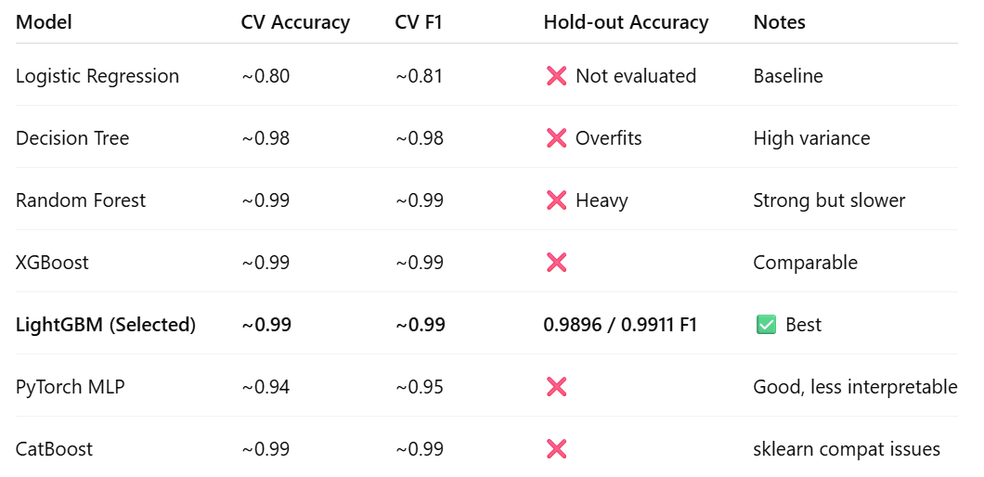
Packaging – Wrapper Predictions
Models were compared using stratified 10-fold cross-validation to assess stability, generalisation, and variance across folds.
Simpler models underperformed due to strong non-linear feature interactions, while some high-capacity models introduced operational trade-offs such as overfitting risk, inference cost, or deployment complexity.
LightGBM achieved the best balance of recall, stability, inference speed, and deployment simplicity, making it the most suitable candidate for production use.
Notes:
This table summarises the full model selection process. While several ensemble models achieved similar cross-validation performance, not all were suitable for deployment. Decision trees overfit, random forests were heavy at inference time, and CatBoost introduced compatibility issues. LightGBM provided equivalent performance with lower operational complexity, making it the most robust and deployable choice

Slide 17
Web Application & CI/CD
A Flask web application was deployed to demonstrate end-to-end usability and production inference.
A full CI/CD pipeline was implemented using GitHub Actions, automatically running unit, integration, and smoke tests on every push. Deployment is gated on passing tests, preventing unvalidated ML code from reaching production.
This design ensures that:
preprocessing and inference behave correctly outside the training environment
model predictions remain stable as the codebase evolves
regressions are detected immediately through automated testing
The web interface validates usability, while CI/CD enforces correctness, reliability, and engineering discipline — aligning the project with real-world machine learning deployment practices.
Appendix J – Testing – GItHUB Actions CI/CD Pipeline
Notes:
This stage validates that the model works outside the training environment. CI/CD ensures every code change is tested and that deployment only occurs when inference, preprocessing, and API behaviour remain correct. This mirrors real-world ML engineering practice, not just academic experimentation

Slide 18
Testing
Testing validates not only correctness, but deployment readiness and system stability.
✅ Testing
Write unit tests (at least the health + route tests)
Write integration tests (your CLI/app route tests count here)
Because: pytest ran and 4 tests passed.
✅ Web App
Build Flask UI form input ✅ (app starts and serves at /)
Add /health endpoint ✅ (health test passed)
Add CSV upload predictions ✅ (implemented /predict-csv and tests are passing)
✅ Local run verified
validated “runs locally” because python app.py launched and is serving on http://127.0.0.1:5000.
Appendix J and Appendix K

Slide 19
Key Findings
Data leakage silently invalidated early cross-validation results, producing unrealistically strong metrics until preprocessing was moved inside a pipeline
Embedding preprocessing inside a Scikit-learn Pipeline was essential to achieve trustworthy, reproducible cross-validation estimates
Tree-based ensemble models consistently outperformed linear baselines, confirming that malware detection in this dataset is dominated by non-linear feature interactions
Deployment constraints influenced final model selection, favouring LightGBM for its balance of recall, generalisation, and inference efficiency
This project demonstrated that ML systems must be engineered end-to-end, not just trained — spanning evaluation discipline, packaging, CI/CD, and production inference
Notes:
These findings were not theoretical. Each one reflects a design correction made during the project — particularly the discovery of data leakage, the move to pipeline-based preprocessing, and the shift toward ensemble models. The project ultimately reinforced that strong ML results come from engineering discipline, not headline metrics

Slide 20
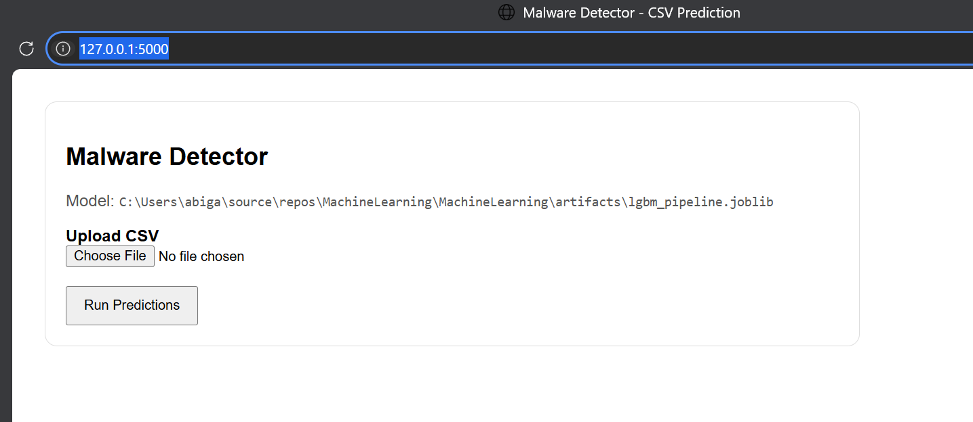
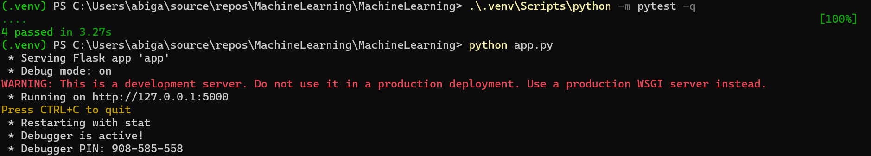
Local Host – Malware Detector
“The Flask application runs locally, exposes a /health endpoint, supports CSV prediction upload, and all automated tests pass successfully.”

Slide 21
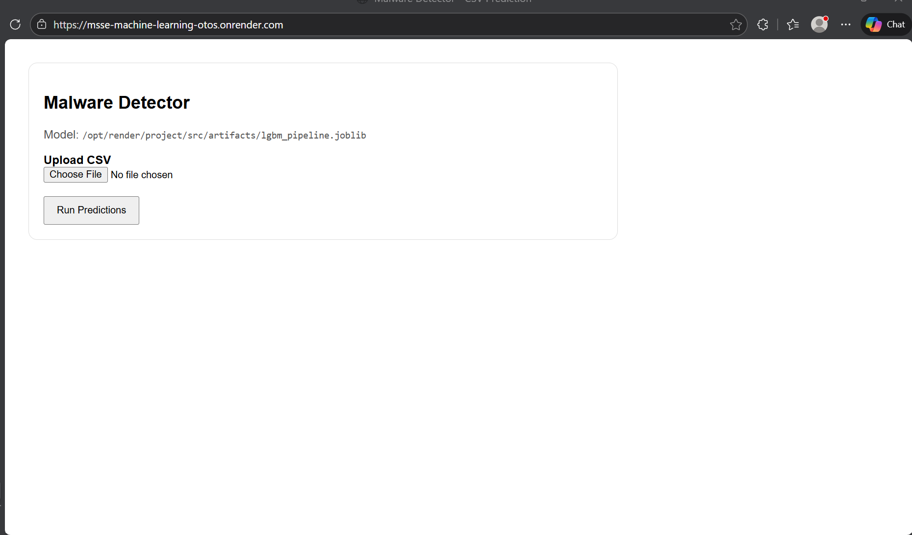
Host and Deploy

Slide 22
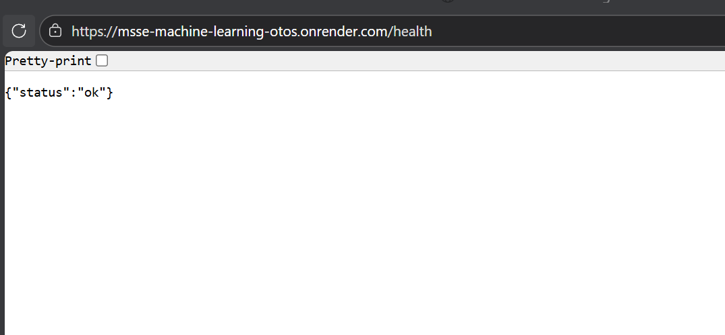
Web Health Check

Slide 23
Host and Deployment
# Deployment
Local Host: Malware Detector - CSV Prediction
Live application URL:
https://msse-machine-learning-otos.onrender.com
Health check endpoint:
https://msse-machine-learning-otos.onrender.com/health
Status:
Deployed on Render (free tier)

Slide 24
CI/CD (Continuous Integration & Deployment)
This project implements a production-aligned CI/CD pipeline using GitHub Actions to automatically validate model code, preprocessing logic, and application behaviour before deployment. The pipeline enforces evaluation discipline by preventing untested ML changes from reaching production.
Pipeline guarantees:
Automated unit, integration, and smoke tests execute on every push
Deployment is gated on passing tests, preventing regressions and invalid model behaviour
Preprocessing and inference logic are validated outside the training environment, ensuring real-world correctness
The pipeline is intentionally lightweight to remain compatible with free-tier hosting constraints
Engineering impact: CI/CD transforms the project from an experimental notebook workflow into a reliable, production-ready ML system, where correctness, reproducibility, and deployment safety are enforced automatically rather than assumed.
Notes:
Intent: To ensure model changes could not silently degrade system behaviour. Decision: We introduced automated unit, integration, and smoke tests gated by GitHub Actions prior to deployment. Outcome: Only validated builds are deployed, improving reliability and reducing regression risk.
The CI/CD pipeline was not added for convenience — it was added to enforce discipline. Every change to preprocessing, inference, or API logic is automatically tested, and deployment is blocked unless those tests pass. This ensures the model behaves correctly outside the training environment and prevents silent regressions, which is critical for real-world ML systems.

Slide 25
Deployment Validation
After deployment:
The /health endpoint was manually verified and returned:
{"status": "ok"}
This confirms that the application is live, responsive, and correctly initialised.

Slide 26
CI/CD Quality Gates
Enforced quality gate Deployment is strictly blocked unless all automated CI checks pass.
What is gated:
Unit tests validating preprocessing and inference logic
Integration tests covering end-to-end prediction flow
Smoke tests ensuring the deployed application starts and responds correctly
Why this matters for ML systems:
Prevents silent regressions in preprocessing or inference logic
Ensures model behaviour remains consistent across environments
Guarantees reproducibility by enforcing the same validation on every change
Engineering outcome: This quality gate ensures the system evolves safely, transforming the project from an experimental ML workflow into a reliable, production-grade deployment.
Notes:
This quality gate is the key enforcement mechanism in the project. Any change to model code, preprocessing, or application logic must pass automated validation before deployment. This prevents silent failures — especially dangerous in ML systems — and ensures reproducibility and reliability across environments

Slide 27
Conclusion
This project demonstrates that high-performing machine learning systems are engineered, not discovered. Strong results required disciplined data handling, leakage-safe evaluation, and production-aware design — not just model tuning.
By enforcing strict train–test separation, embedding preprocessing within cross-validation pipelines, and validating performance on a locked hold-out test set, the project produced trustworthy and reproducible results suitable for real-world deployment.
The integration of automated testing, CI/CD quality gates, and deployment further ensured that model behaviour remains correct outside the training environment, bridging the gap between experimentation and production.
Key takeaway: Reliable machine learning systems emerge when evaluation integrity, testing, and deployment are treated as first-class engineering concerns.
Notes:
The main lesson from this project is that strong ML performance is a consequence of engineering discipline. Leakage-safe evaluation, pipelines, testing, and deployment practices mattered more than chasing marginal model improvements. This approach produced results that are not only accurate, but reliable and deployable

Slide 28
APPENDIX
SUPPORTING MATERIAL

Slide 29
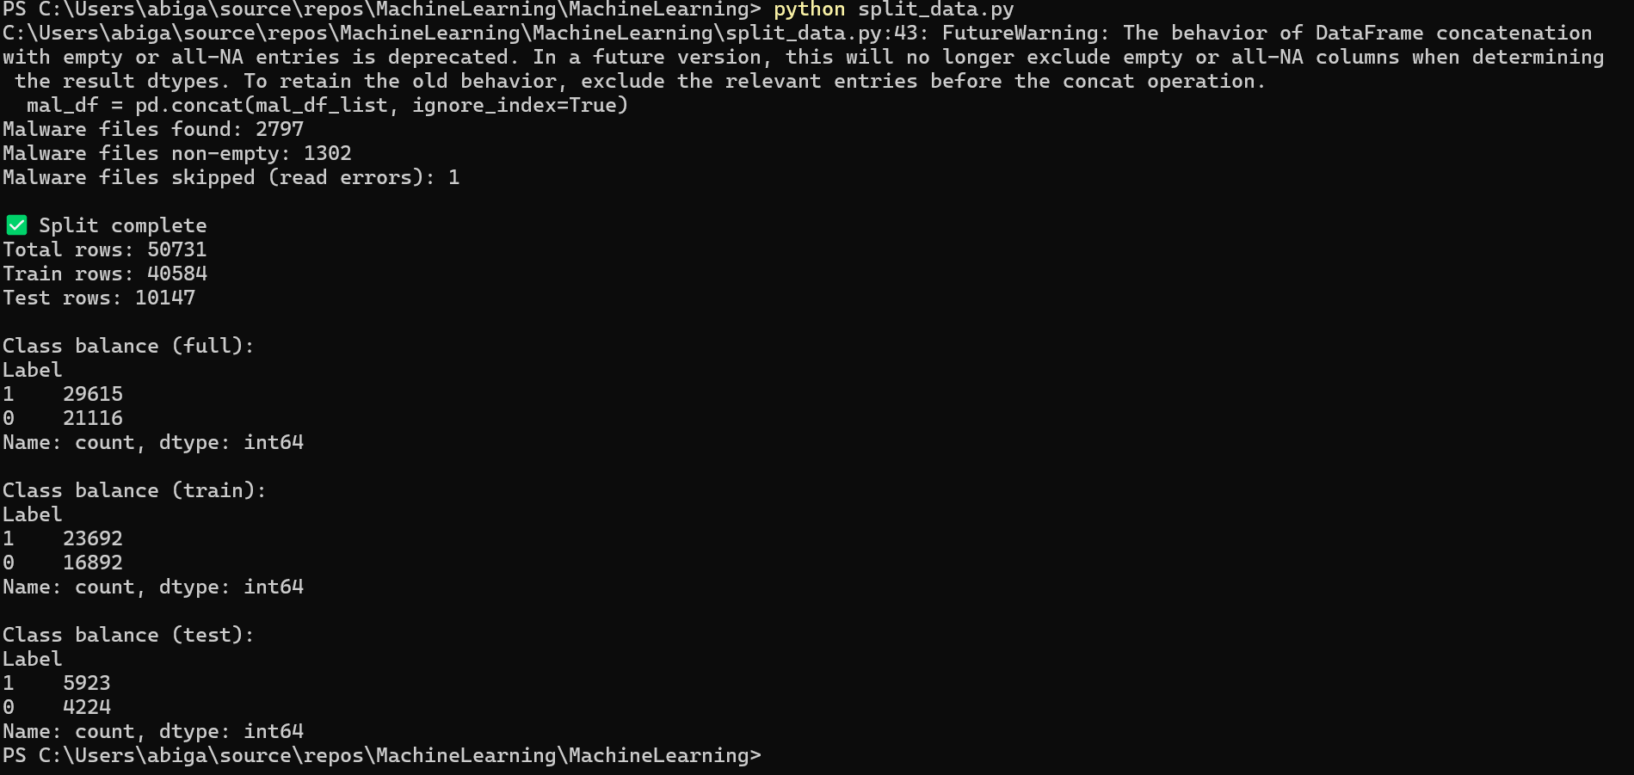
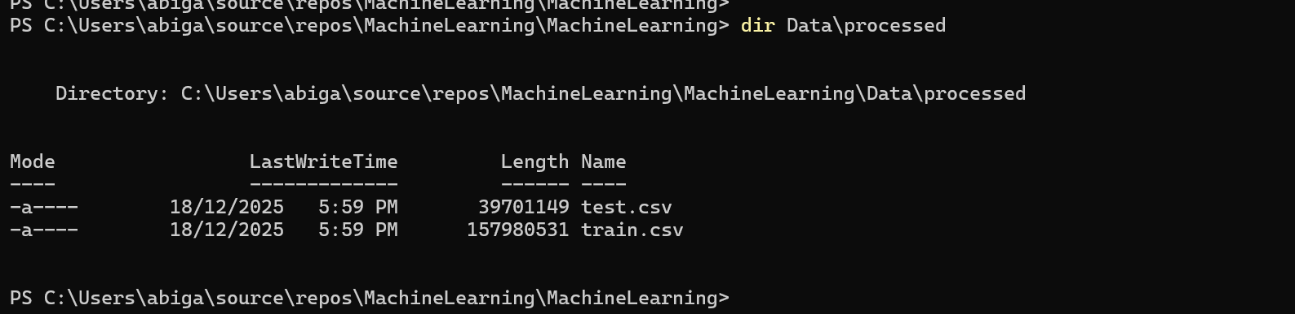
Appendix A Stratified 80/20 train-test split

Slide 30
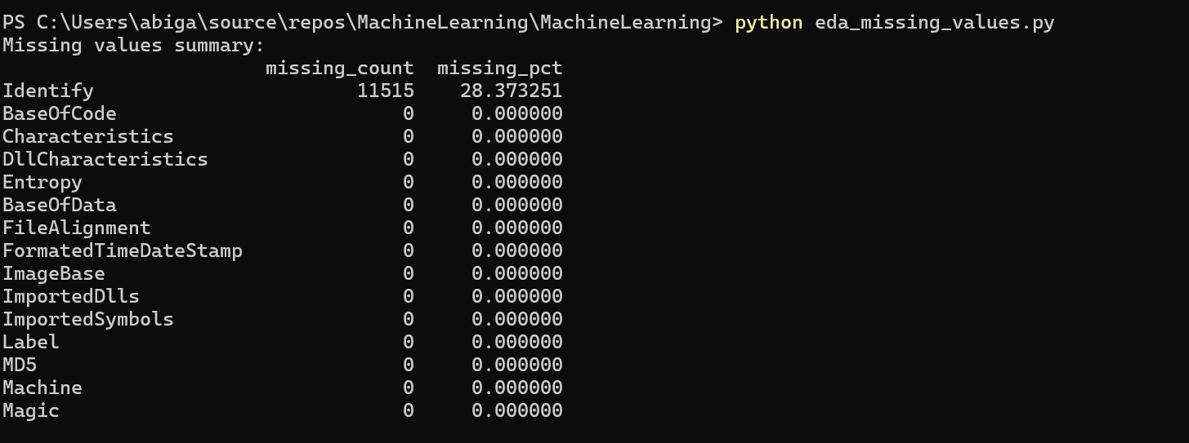
Appendix B EDA Missing Values

Slide 31
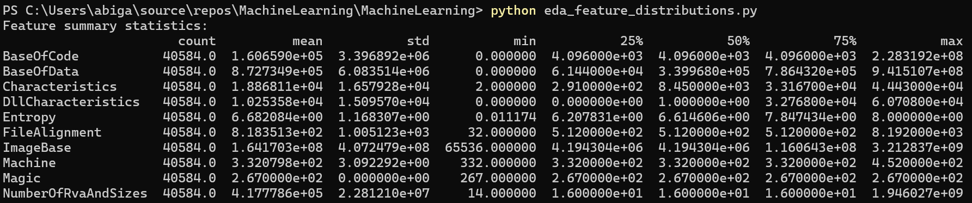
Appendix C: Feature Distributions

Slide 32
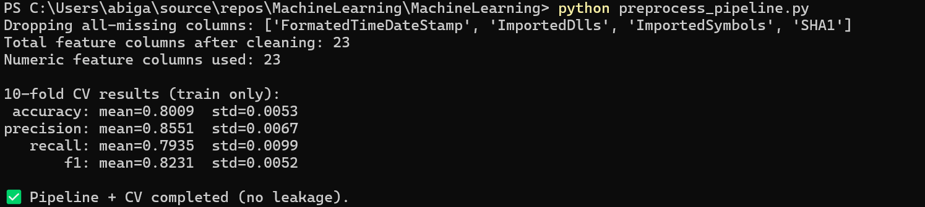
Appendix D: sklearn Pipeline (impute & scale)

Slide 33
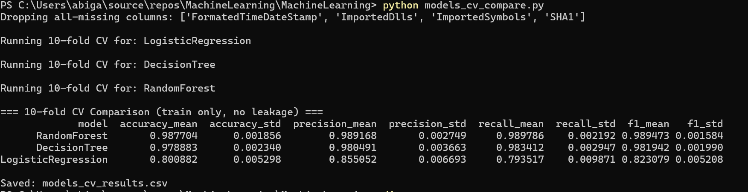
Appendix E: Models

Slide 34
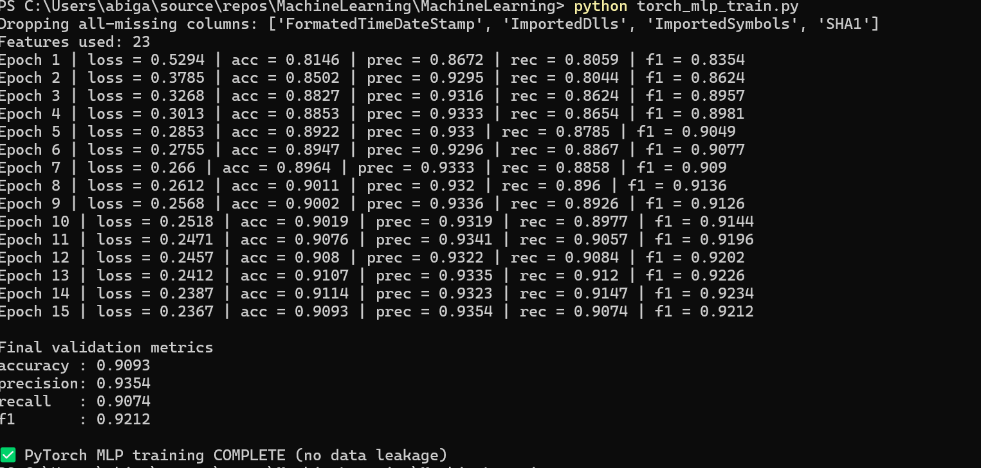
Appendix F: PyTorch MLP

Slide 35
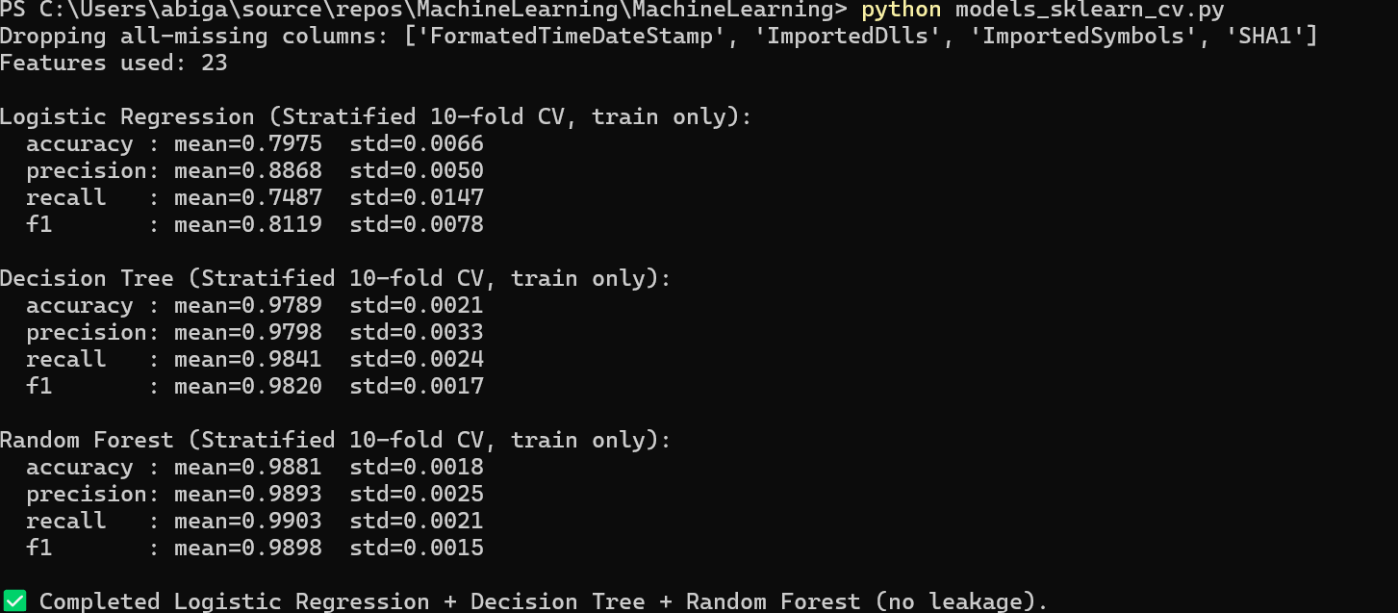
Appendix G: Logic Regression Regression (10-fold CV) ✅ Decision Tree (10-fold CV) ✅ Random Forest (10-fold CV)

Slide 36
Appendix H: Confusion Matrix
[[4159 65]
[ 41 5882]]

Slide 37
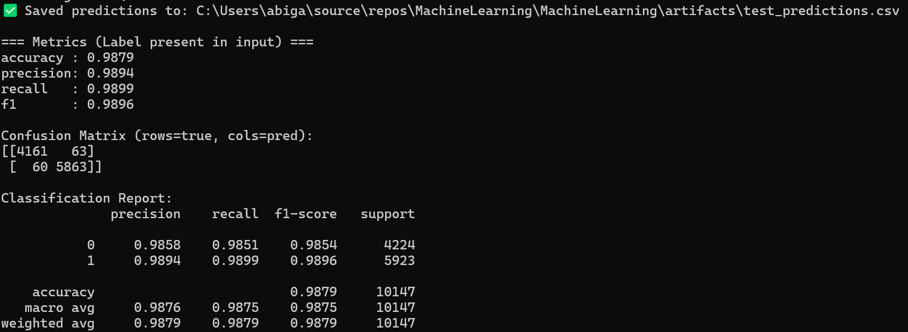
Appendix i: Predictions

Slide 38
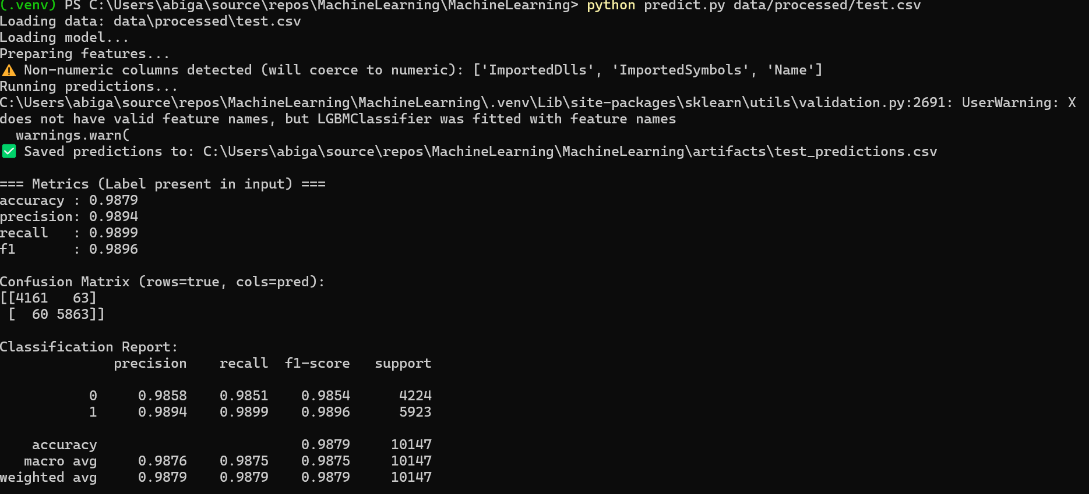
Appendix J: Unit Testing

Slide 39
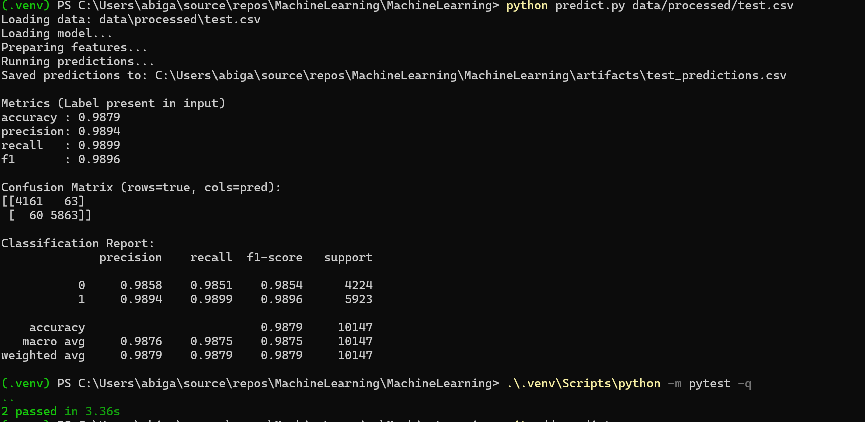
Appendix K: Unit Testing

Slide 40
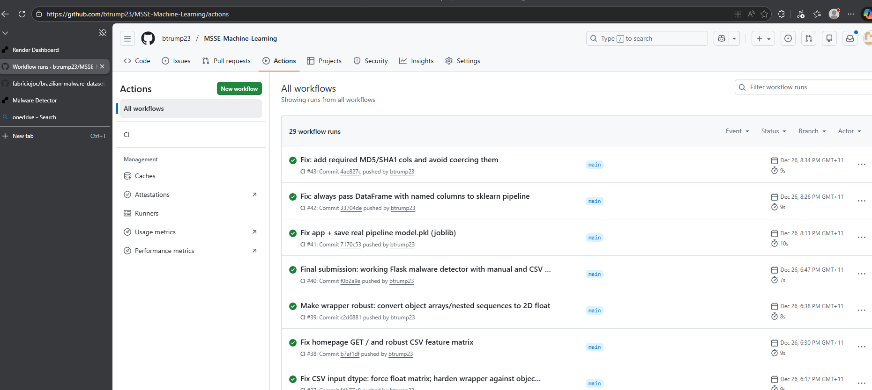
Appendix J: GIThub CI/CD Testing

Slide 41
REFERENCES
SUPPORTING REFERENCES

Slide 42
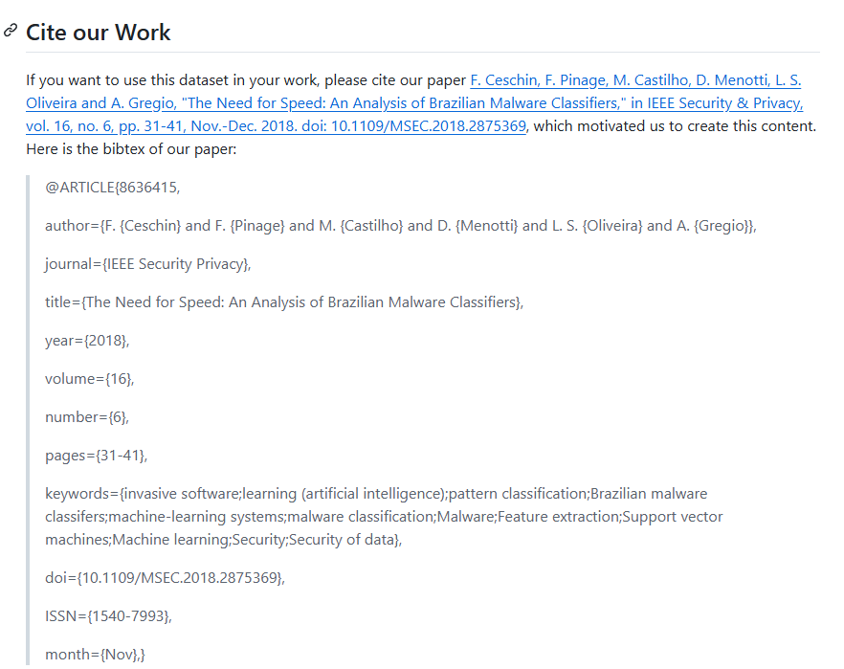
References
DATASET- brazilian-malware-dataset

Slide 43
References
chatGTP
Project Video can be found here

